Slide 1

Golden Eagles

Slide 2


Team Member’s
Associate With GLS University
Sahil Soni
Rohit Bera
Harsh Chalodiya
Jemish Kachhadiya
Krushnarajsinh Vaghela
Mail id - krushnaraj11@gmail.com

Slide 3
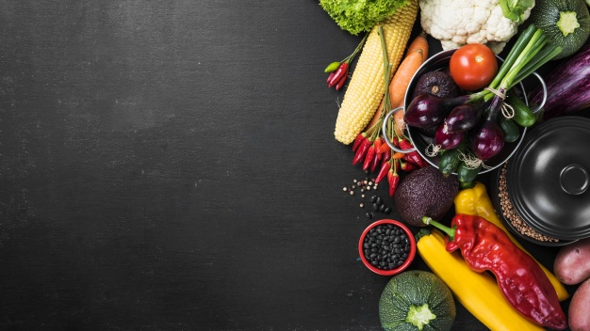

F
reshMeal

Slide 4

Problem definition

Slide 5
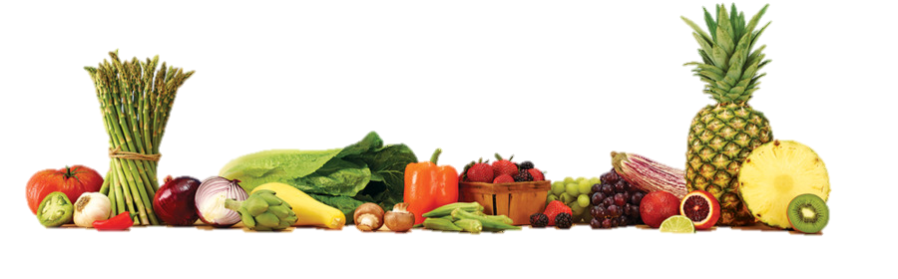
Problem Definition
Our Project Name is FreshMeal .
Our project name and our concept both are based on Fresh Meal .
Recently we have seen that many of the resident people and fitness freak people
are now a days are finding a spot to complete their day with a fresh and good
meal which gives then various options to choose from at a very minor cost .

Slide 6
Market survey

Slide 7
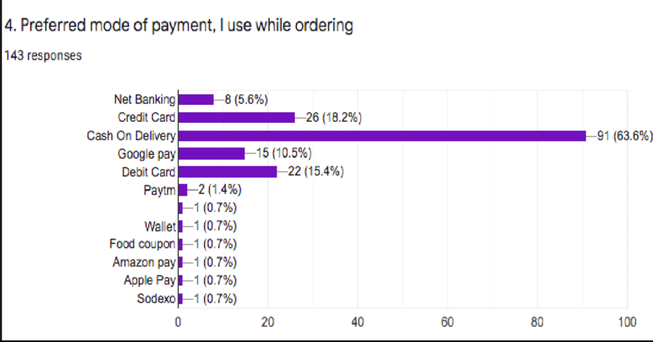

Slide 8
Delivery Charges
As compared to Swiggy delivery charges of Swiggy is approximate charges are 30 to 40 rupees in radius of 3 to 5 km but we provide free delivery in radius of 3 to 5 km .
Payment Option
We Provide 100% cash on delivery option and also provide other option like Debit Card , Credit Card and all other online payment option .
Our Website Prefer equal payment option as compare to other competitors .
Give to Online Payment Fraud we provide our customer 100% cash on delivery Services and Sequre online payment gateway .

Slide 9
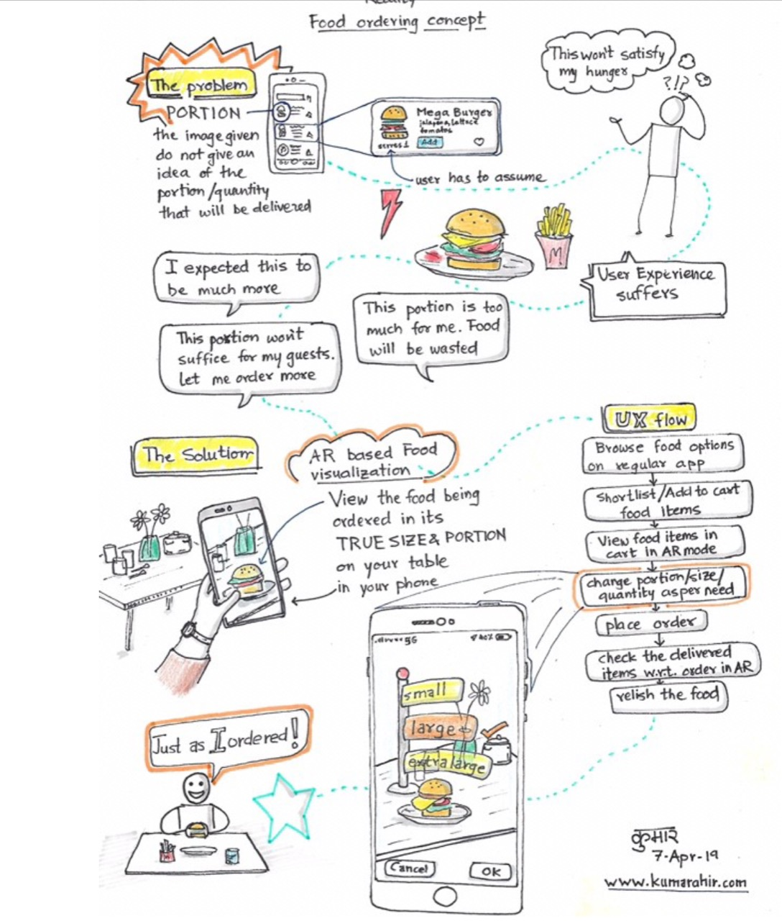
Similar Prototype

Slide 10
Types of services
we offer to our customer.

Slide 11
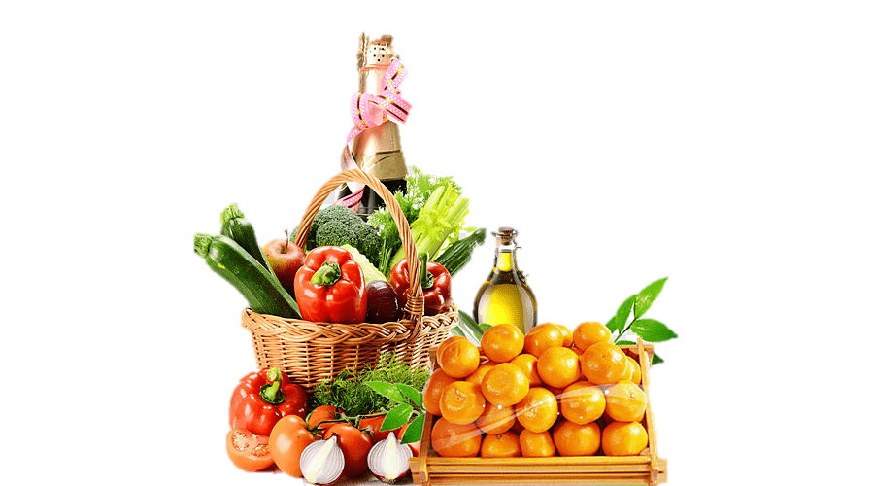
Services
They can order food at home
If they just want to see the recipes of the food they can see
We also provide free delivery in 30 minutes in radius of 10 km
We provide quality and better food service
Customer can provide us their FeedBack

Slide 12
Languages we have Used
REACT JS
As Frontend
Node-express js
As Frontend
Mongodb
Backend
HTML
As Frontend

Slide 13

Brief Information
React Js is a single page application .
It Hardly requires to refresh in webpage .
It has many components and links are created using React .
Fresh Meal web app is made up of components including JSX , CSS , HTML , jQuery as Frontend and Node-express js and mongo dB is used as backend .

Slide 14
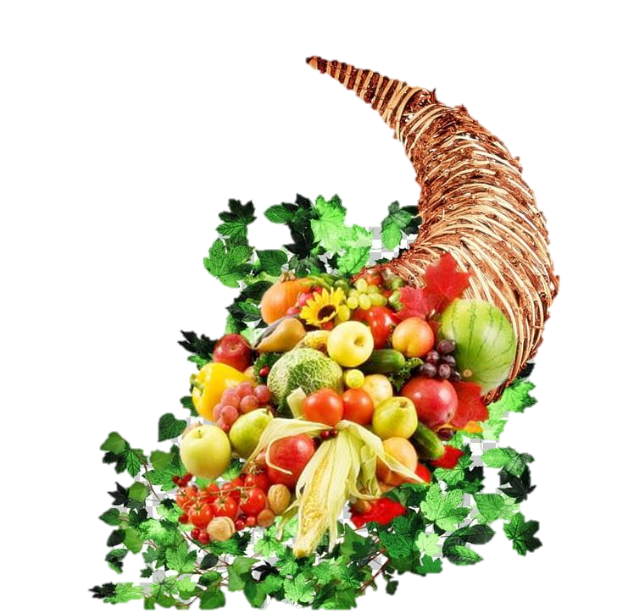
In React hooks are used like Use State , Use Effect , Use History for routing browser-route and link for routing .
In Node Express js is used and Various other node-package-module
Like axios , mongoose .
Node used to create API like get and post request , operations Performed on mongo database and axios is used to run those APIs in react .

Slide 15
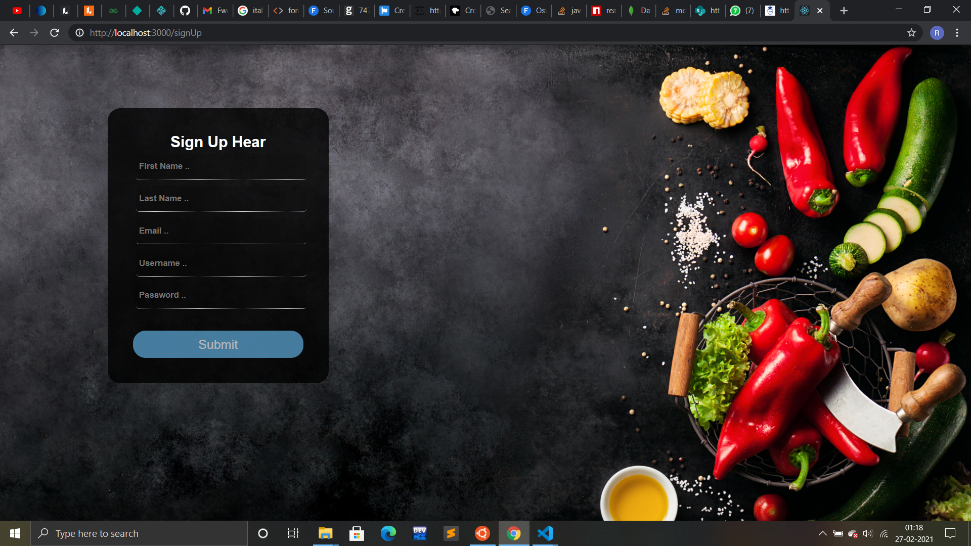
Registration Section

Slide 16
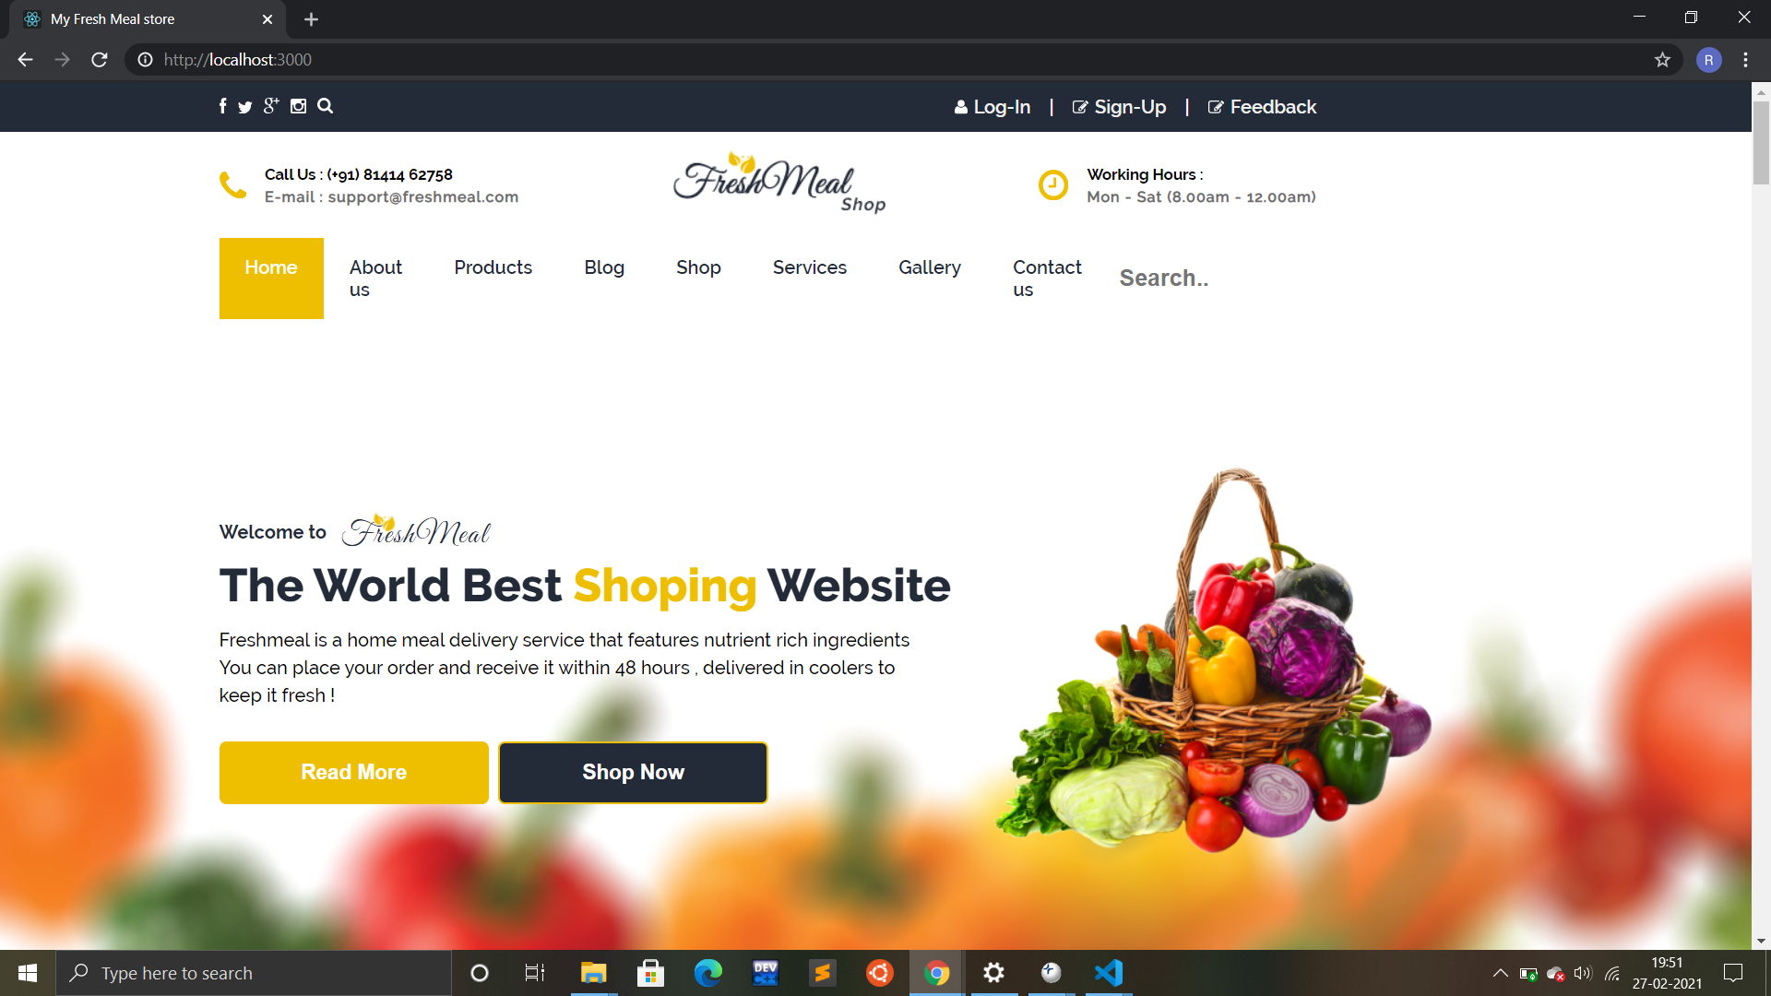
Front Section

Slide 17
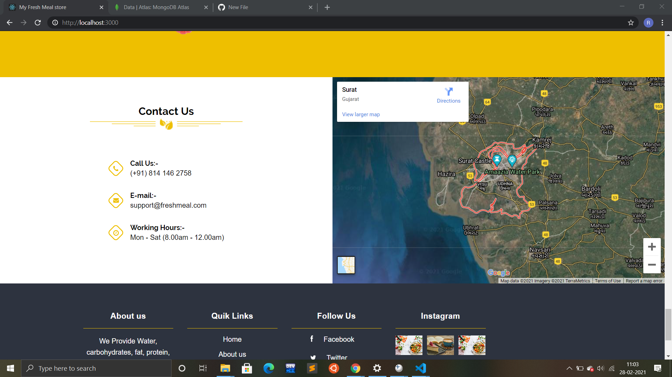
Contact Section

Slide 18
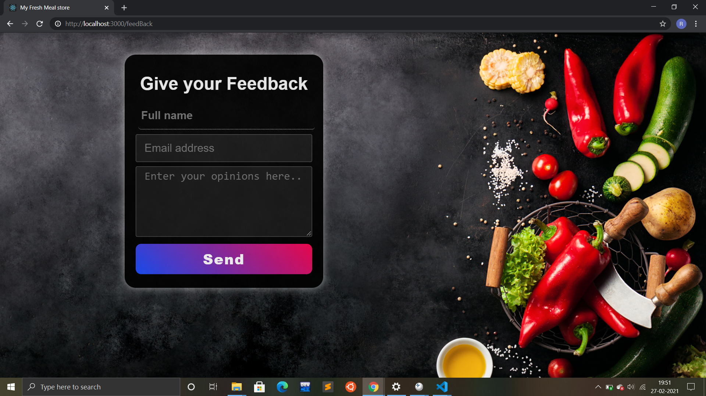
Feedback Section

Slide 19
Our competitors

Slide 20


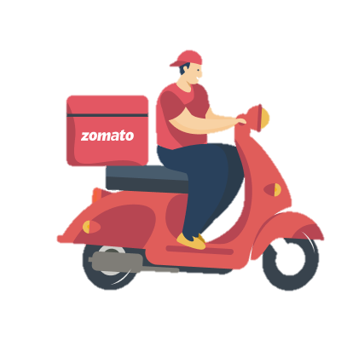
Uber Eats
ZOMATO

Slide 21
FUTURE IMPLEMENTATIONS

Slide 22
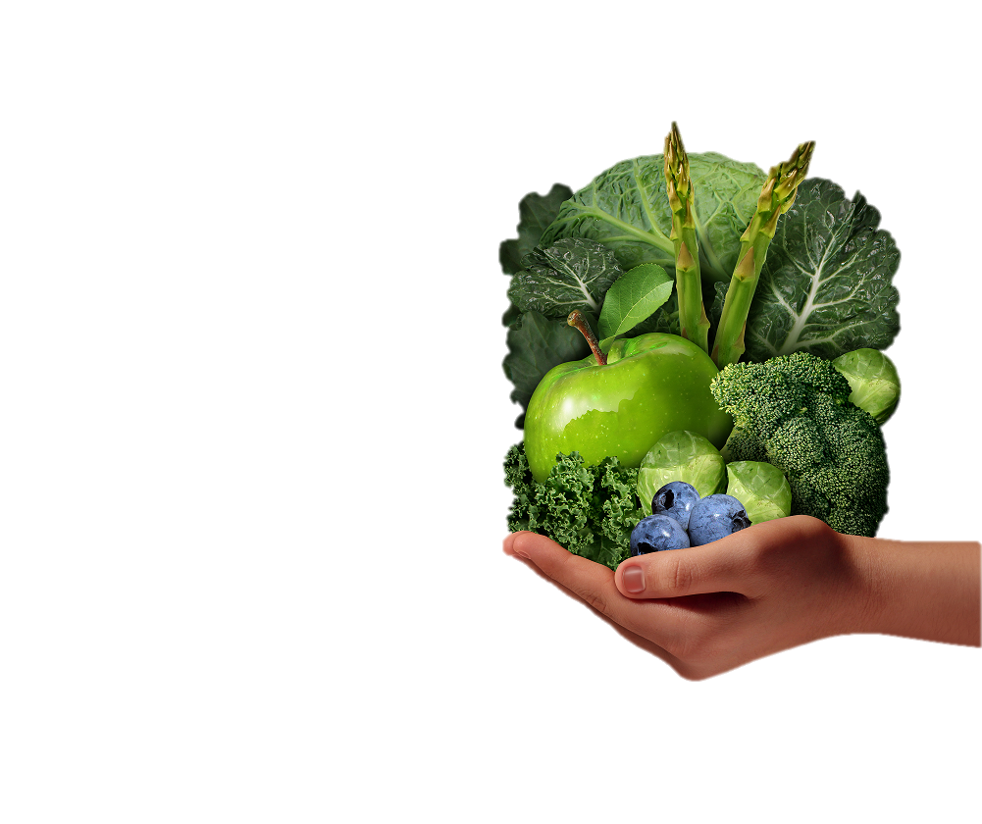
FUSION
Basically what fusion will do is that if a customer don’t
want to choose a dish from our menu .
But he/she wants to make a new dish with existing
elements in some another dish then he/she can add
specific types of vegetable they want which ingredients
to use and which oil to use etc.
So a customer can basically customized his own food according
to his need or according to his current mood .

Slide 23
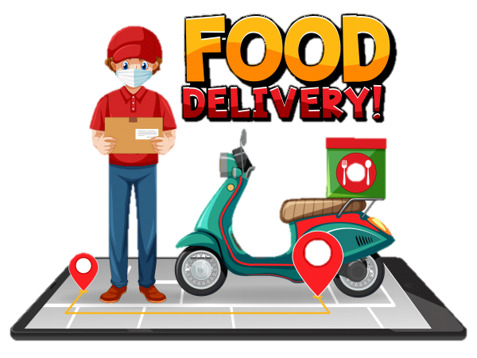
Home Cook
The Home Cook option is for the customer who wants to eat outdoor food but they want it to prepared in home only so they can avoid going out and can enjoy the same food so here we will provide the betters at their home.
Example
If a couple is a working couple and they want to enjoy eating dosa but they don’t want to go out.
And at the same time they want to eat home made dosa then they just have to order dosa batter and we will deliver the better at their door step.

Slide 24
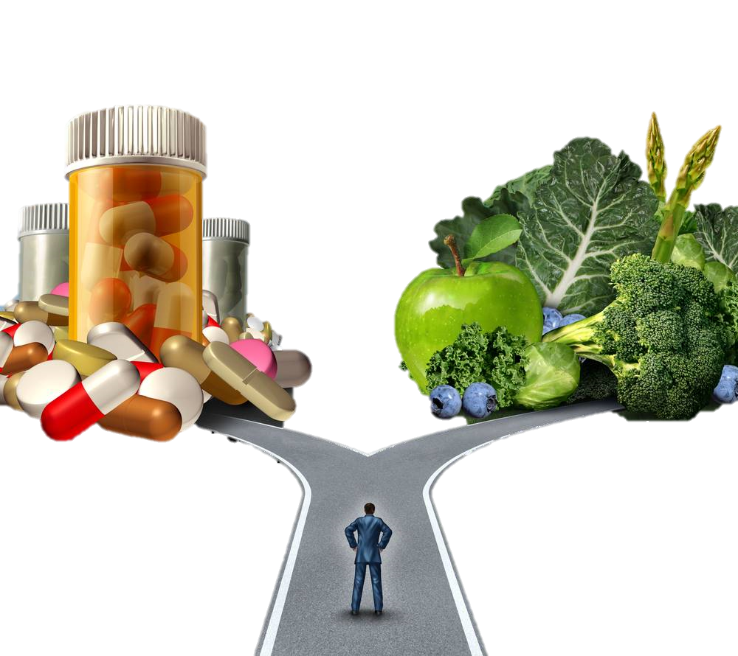
Conclusion
We are trying to makes lives of the people
better and easy by proving quality of food
to them at their door step and we are here
to protect them from unhygienic food and
from the frozen food to so we are moving
toward a health mission through which we
can save lives of people and help them to
live better.

Slide 25

GITHUB LINK OF OUR PROJECT
https://github.com/Rohit-Bera/Golden-Eagles

Slide 26
T
hank You

